Slide 1
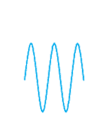

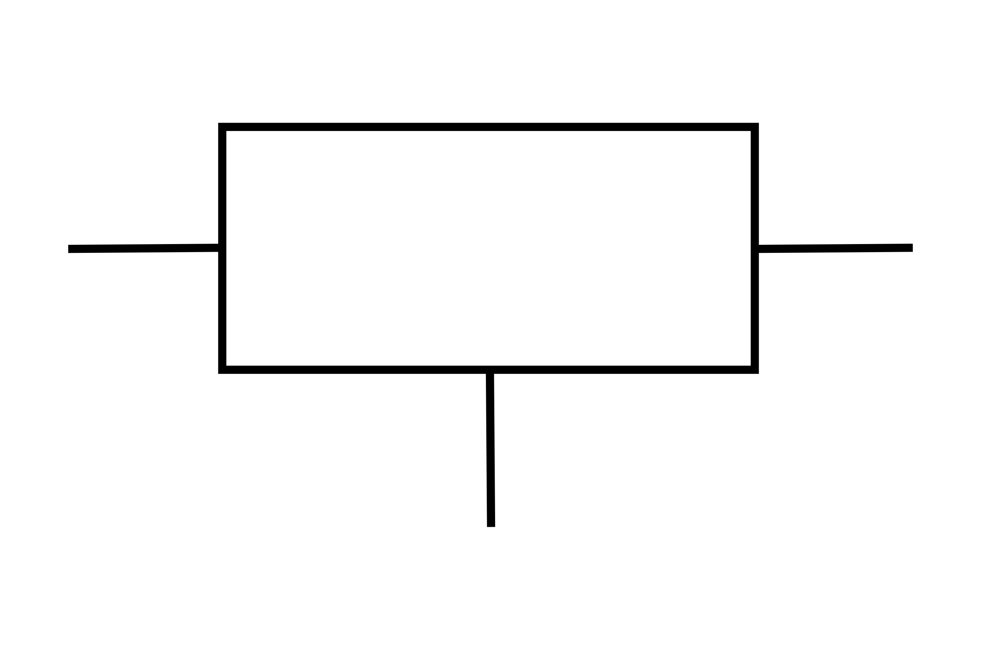
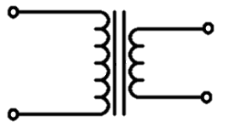
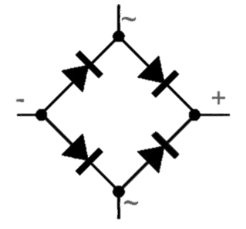
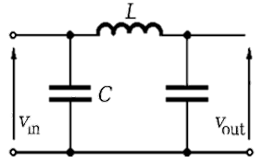
LINEAR POWER SUPLLY
Transformer
Rectifier
Filter
Regulator
Load

Slide 2
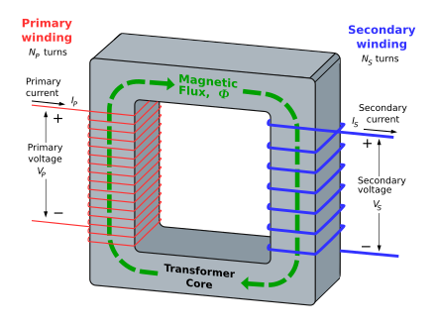
$V_{S}$ $=−N_{S}\frac{ⅆφ}{ⅆt}$

Slide 3
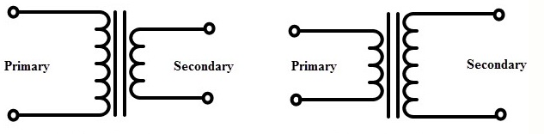

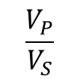
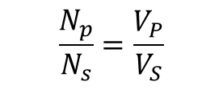

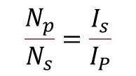

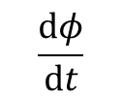

TRANSFORMER
Step down
Transformer
Step up
Transformer
Center tap Transformer
Types of transformer
Basic Formulas
$$\frac{N_{p}}{N_{s}}=\frac{V_{P}}{V_{S}}$$
$$\frac{N_{p}}{N_{s}}=\frac{I_{s}}{I_{P}}$$
$V_{P}$ $=−N_{P}\frac{ⅆφ}{ⅆt}$
$V_{S}$ $=−N_{S}\frac{ⅆφ}{ⅆt}$
$$\frac{V_{P}}{V_{S}}$$
Voltage of primary/ input
$$\frac{N_{p}}{N_{s}}$$
Number of primary turns
$$\frac{ⅆφ}{ⅆt}$$
Change of magnetic flux
Voltage of secondary
Number of secondary turns
Change of time

Slide 4
TYPES OF REGULATED LINEAR POWER SUPPLY
Linear Power Supply
Series Regulated Linear Power Supply
Shunt Regulated Linear Power Supply

